Slide 1
MECHENG 754: Management and Control of Electric Vehicle Batteries
Battery Electrochemical Modelling
Dr. Ryan Ahmed & Junran Chen
ryan.ahmed@mcmaster.ca & chenj425@mcmaster.ca
Office: McMaster Automotive Resource Center (MARC)
Center of Mechatronics and Hybrid Technologies (CMHT)
Notes:
Hi everyone, my name is Junran Chen, I am a PhD student supervised by Dr. Ali Emadi.
Today, I feel very honored to be invited by Dr. Ahmed to share my understanding about battery electrochemical modelling.
During our session today, please feel free to drop in whenever you have any questions, I want you to think it’s more like a discussion instead of a lecture.

Slide 2
OUTLINE
Introduction to Batteries Operation In Electrochemical Aspect
Doyle-Fuller-Newman (DFN)/Pseudo-Two-Dimensional (P2D) Model
DFN Model MATLAB Code Demo
PyBaMM - Python Based Electrochemical Modelling Demo
Potential Group Projects
Notes:
Here is the outline for today’s session.
First, we will go through how battery operate in electrochemical aspect.
Then, I will introduce a very popular electrochemical model, DFN also named P2D model.
Then, I will show two code demos, one is DFN modeling using MATLAB, other one is PyBaMM, which is a python based electrochemical modelling tool..
In the end, I will give some suggestions about potential group projects for this course using electrochemical model.

Slide 3
INTRODUCTION TO BATTERIES OPERATION IN ELECTROCHEMICAL ASPECT

Slide 4
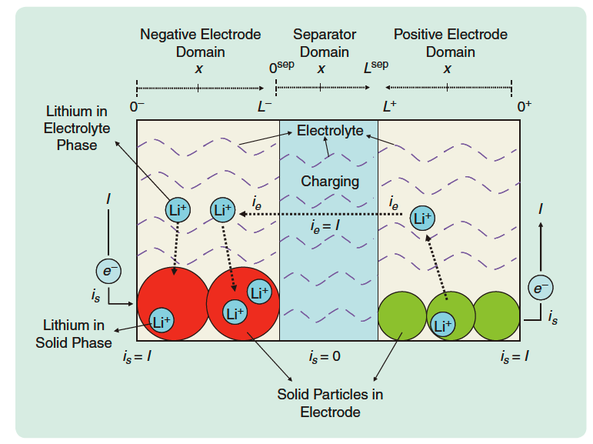
[1] N. A. Chaturvedi, R. Klein, J. Christensen, J. Ahmed, and A. Kojic, "Algorithms for Advanced Battery-Management Systems," IEEE Control Systems Magazine, vol. 30, no. 3, pp. 49-68, 2010, doi: 10.1109/MCS.2010.936293.
INTRODUCTION: How battery works in electrochemical aspect?
(Anode)
(Cathode)
Four main components:
Negative electrode (Anode): active material - Graphite
Positive electrode (Cathode): active material – Metal Oxide (e.g., NMC – Li_{x}Mn₂O₄, LCO – Li_{x}CoO₂)
Electrolyte: Concentrated solution that allows Lithium ions dissolved and moving around in a battery cell.
Separator: electrical insulator (electrons 🚫🚫), but allows lithium ion to pass through by the means of the electrolyte (Lithium ion 👏👏).
Notes:
When I first get a battery, I feel it’s very mysterious what battery is made of and how such a small thing can store energy, and generate current and voltage.
With those questions in mind, let’s first check what a lithium ion battery is made of.
Lithium-ion battery is made of four components:
First, negative electrode, or Anode, its active material is Graphite.
And Correspondingly, we have positive electrode, or Cathode, whose active material is Lithium metal Oxide.
One knowledge here is since most lithium ion battery’s anode is made by graphite, when we talk about different chemistry of lithium ion battery, we usually only mean cathode material.
For example, here are the Cathode materials for NMC and LCO cells, and you can see that they are only named by Cathode material.
The third component is electrolyte, which is concentrated solution that allows lithium ion dissolved and moving around in a battery.
The lithium ions in a battery have two phases, it’s either dissolved in the electrolyte, or it will store as solid phase in these round sold particle maded of electrode active material. In Cathode, these particles will be lithium-metal oxide, and in anode, it will be graphite.
The fourth component is separator, it is electrical insulator, which means electrons cannot pass through it. However, Lithium ions are allowed to pass through by the means of the electrolyte dissolved phase.

Slide 5
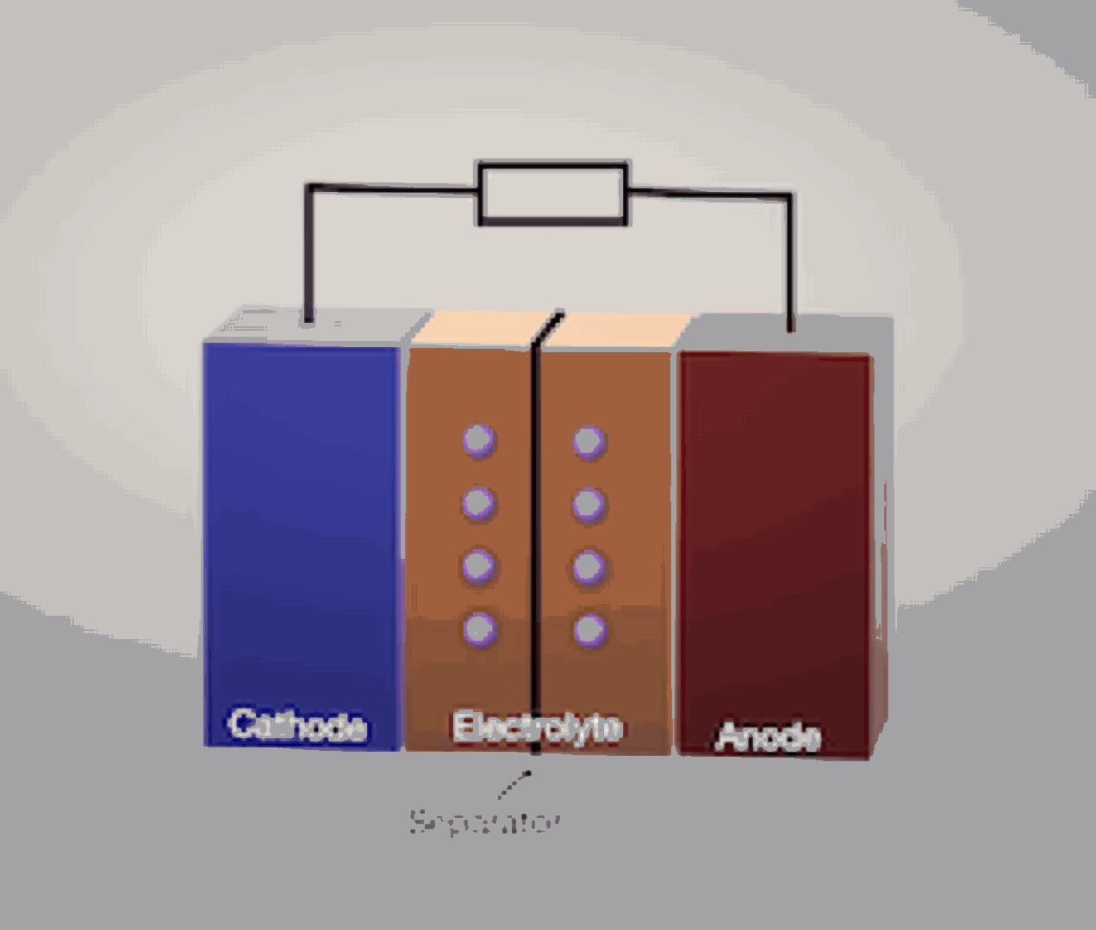
https://www.chemtube3d.com/lib_homepage-2/
INTRODUCTION: How battery works in electrochemical aspect?
Notes:
Here is the process of how lithium ion and electrons move during battery operation.
One question: Can anyone tell me in this figure, the battery is charging or discharging? -> Charging

Slide 6
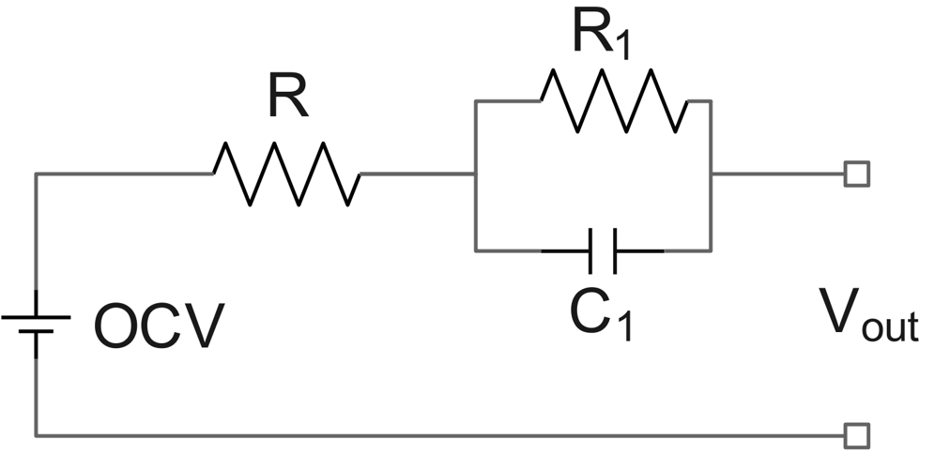
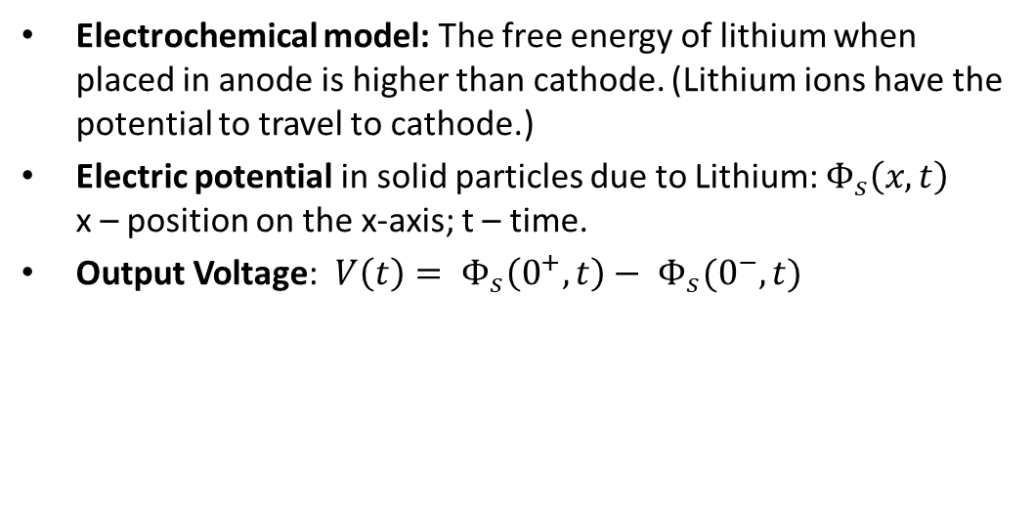
[1] N. A. Chaturvedi, R. Klein, J. Christensen, J. Ahmed, and A. Kojic, "Algorithms for Advanced Battery-Management Systems," IEEE Control Systems Magazine, vol. 30, no. 3, pp. 49-68, 2010, doi: 10.1109/MCS.2010.936293.
INTRODUCTION: How battery has voltage, current and resistance?
(Anode)
(Cathode)
Voltage
ECM model: A voltage source is used to simulate battery open-circuit voltage.
I
Equivalent circuit model
Electrochemical model: The free energy of lithium when placed in anode is higher than cathode. (Lithium ions have the potential to travel to cathode.)
Electric potential in solid particles due to Lithium: $Φ_{s}\left(x, t\right)$ x – position on the x-axis; t – time.
Output Voltage: $V\left(t\right)= Φ_{s}\left(0^{+},t\right)− Φ_{s}(0^{−}, t)$
Notes:
Next, our question is how battery generate voltage, current, and resistance?
For an equivalent circuit model, voltage is produced by a voltage source.
But in electrochemical aspect, the main reason of a generated voltage, is because the free energy of lithium ion when placed in anode is higher than cathode.
In this case, lithium ions have the potential to travel from anode to cathode by themselves.
It is this lithium ion potential difference generate voltage.

Slide 7
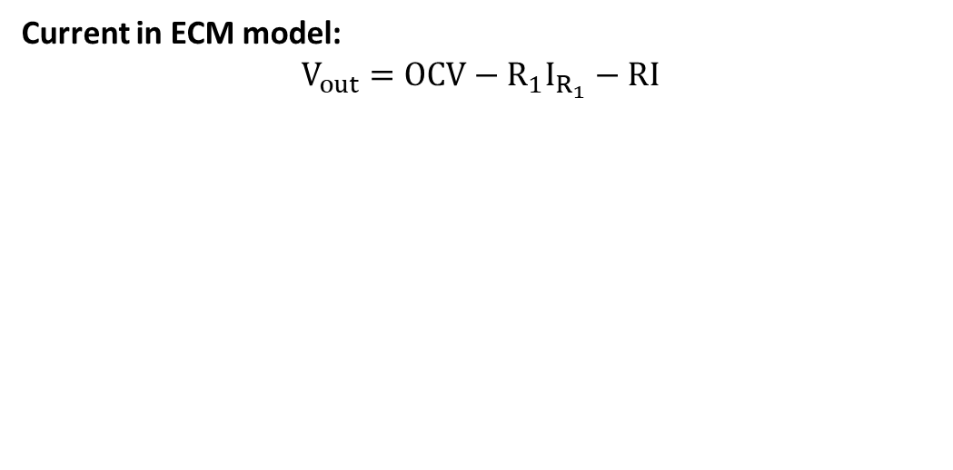
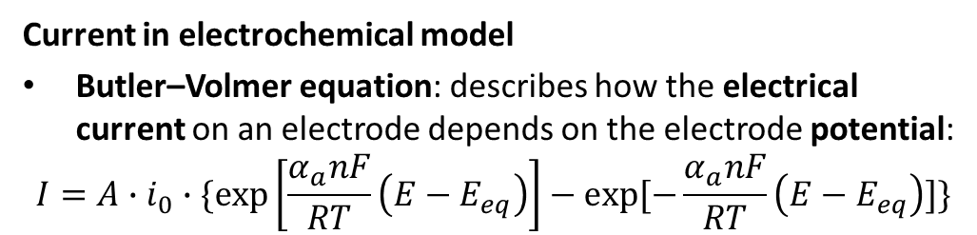
[1] N. A. Chaturvedi, R. Klein, J. Christensen, J. Ahmed, and A. Kojic, "Algorithms for Advanced Battery-Management Systems," IEEE Control Systems Magazine, vol. 30, no. 3, pp. 49-68, 2010, doi: 10.1109/MCS.2010.936293.
INTRODUCTION: How battery has voltage, current and resistance?
(Anode)
(Cathode)
Current in ECM model: $$V_{out}=OCV−{R_{1}I}_{R_{1}}−RI$$
I
Equivalent circuit model
Current in electrochemical model
Butler–Volmer equation: describes how the electrical current on an electrode depends on the electrode potential:
$$I=A∙i_{0}∙\{\exp\left[\frac{α_{a}nF}{RT}\left(E−E_{eq}\right)\right]−exp⁡[−\frac{α_{a}nF}{RT}\left(E−E_{eq}\right)]\}$$
Notes:
Now we know that how voltage is generated because of lithium ion potential.
In electrochemical modelling, battery current can be calculated from lithium ion potential using this Butler-Volmer equation.
The details about this equation can be found in this paper.

Slide 8
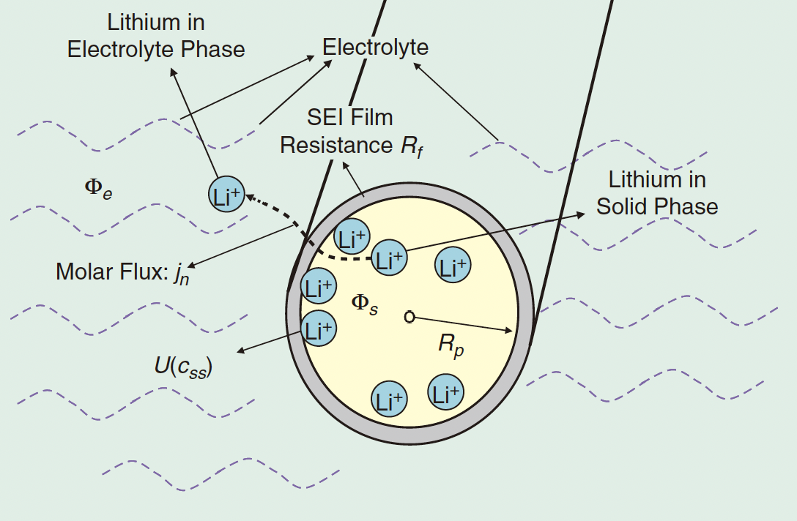
[1] N. A. Chaturvedi, R. Klein, J. Christensen, J. Ahmed, and A. Kojic, "Algorithms for Advanced Battery-Management Systems," IEEE Control Systems Magazine, vol. 30, no. 3, pp. 49-68, 2010, doi: 10.1109/MCS.2010.936293.
INTRODUCTION: How battery has voltage, current and resistance?
(Anode)
(Cathode)
Resistance
Electrochemical model: resistance comes from different aspects, such as the resistance of ion movement through electrolyte, diffusion of ion within electrode, solid electrolyte interphase (SEI) resistance, etc.
Notes:
The last one is resistance, in ECM we use resistor to represent battery internal resistance.
But battery resistance is much more complicated concept, that it can be contributed from different aspects, for example, the resistance can come from the loss of lithium ion moving throughout the electrolyte,
Or the loss because the diffusion of ion within electrode,
Or, the loss because of lithium ion moving accross solid electrolyte interphase, or SEI layer.
(molar flux is the rate of lithium ions travel between electrolyte and solid particles)

Slide 9
Doyle-Fuller-Newman (DFN)/ Pseudo-Two-Dimensional (P2D) MODEL
Notes:
Next, I will give a brief introduction about DFN/P2D model.

Slide 10
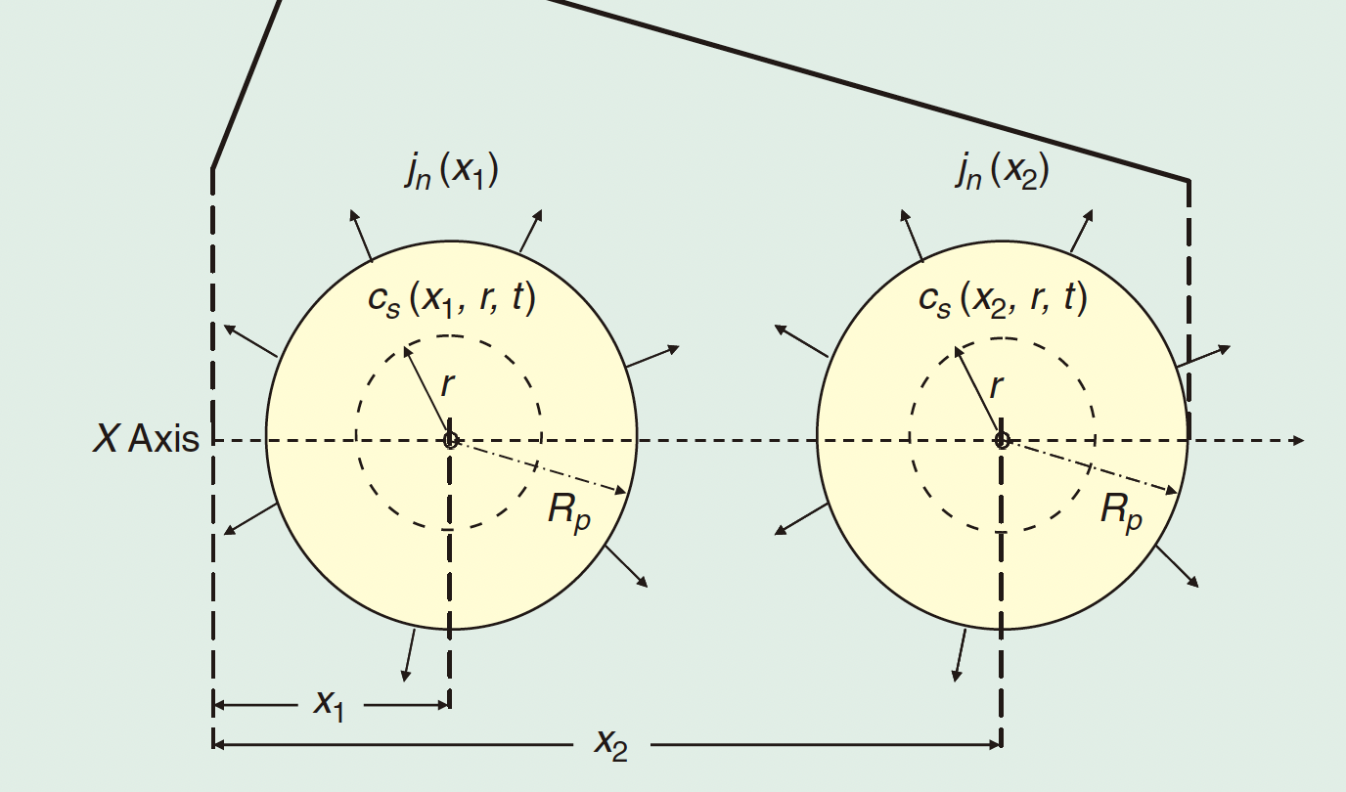
[1] N. A. Chaturvedi, R. Klein, J. Christensen, J. Ahmed, and A. Kojic, "Algorithms for Advanced Battery-Management Systems," IEEE Control Systems Magazine, vol. 30, no. 3, pp. 49-68, 2010, doi: 10.1109/MCS.2010.936293.
DFN/P2D model: Pseudo-2-dimension model
2 dimensions
x – axis
r – distance from the center of the solid particle
Lithium ion concentration
C_{e}(x, t) and C_{s}(x, r, t)– Lithium ion concentration in electrolyte and solid particles
(Anode)
(Cathode)
Notes:
P2D model, is Psudo-2-dimension model. You may have one question, what are these two dimensions?
The first dimension is X-axis, which is along with the thickness of a battery cell from Anode to Cathode.
The second dimension is r, which is the distance r from the center of a solid particle.
Given these two dimensions, many variables inside the cell are functions of these two dimensions.
For example, Lithium ion concentration is a very important variables in DFN model, because if lithium ion concentration is very high in Anode, it means that the battery has very high free energy, or in other words, high SOC.
You can see that the concentration in electrolyte is only a variable to x-axis and time. But in the solid paricle, it’s also related to r, the distance from the center of solid particles.

Slide 11
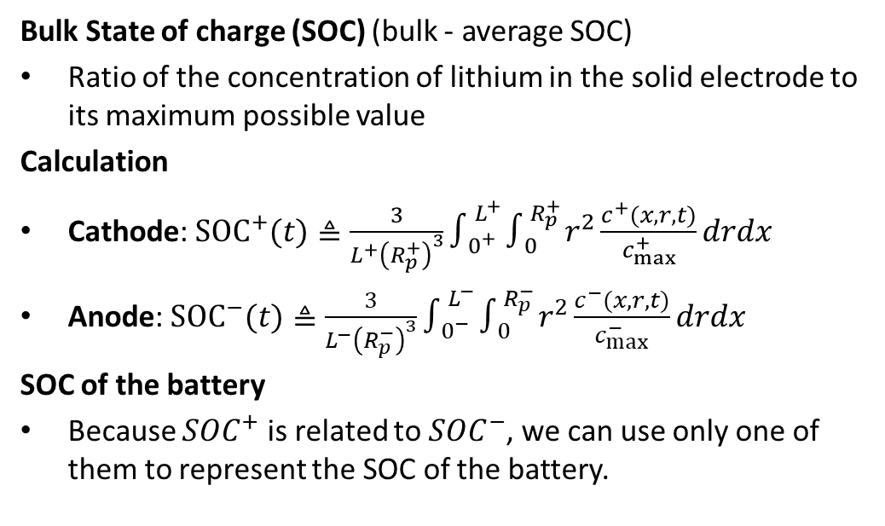
[1] N. A. Chaturvedi, R. Klein, J. Christensen, J. Ahmed, and A. Kojic, "Algorithms for Advanced Battery-Management Systems," IEEE Control Systems Magazine, vol. 30, no. 3, pp. 49-68, 2010, doi: 10.1109/MCS.2010.936293.
DFN/P2D model: SOC calculation
Bulk State of charge (SOC) (bulk - average SOC)
Ratio of the concentration of lithium in the solid electrode to its maximum possible value
Calculation
Cathode: ${SOC}^{+}(t)≜\frac{3}{L^{+}{\left(R_{p}^{+}\right)}^{3}}∫_{0^{+}}^{L^{+}} ∫_{0}^{R_{p}^{+}} r^{2}\frac{c^{+}(x,r,t)}{c_{max}^{+}}drdx$
Anode: ${SOC}^{−}(t)≜\frac{3}{L^{−}{\left(R_{p}^{−}\right)}^{3}}∫_{0^{−}}^{L^{−}} ∫_{0}^{R_{p}^{−}} r^{2}\frac{c^{−}(x,r,t)}{c_{max}^{−}}drdx$
SOC of the battery
Because ${SOC}^{+}$ is related to ${SOC}^{−}$, we can use only one of them to represent the SOC of the battery.
Notes:
As I mentioned, lithium ion concentration can be used to calculation battery SOC.
SOC – the average concentration of lithium ions in cathode over the maximum possible lithium ion concentration in Cathode.
spherical
And the anode SOC is calculated the same way.
SOC in Cathode is related to SOC in anode, because if there is no lithium consumption, lithium ions usually just moves between cathode and anode.
So we can only use one of them to represent the SOC of the entire battery cell.
(bulk means average SOC, because SOC can be different at different points.)

Slide 12
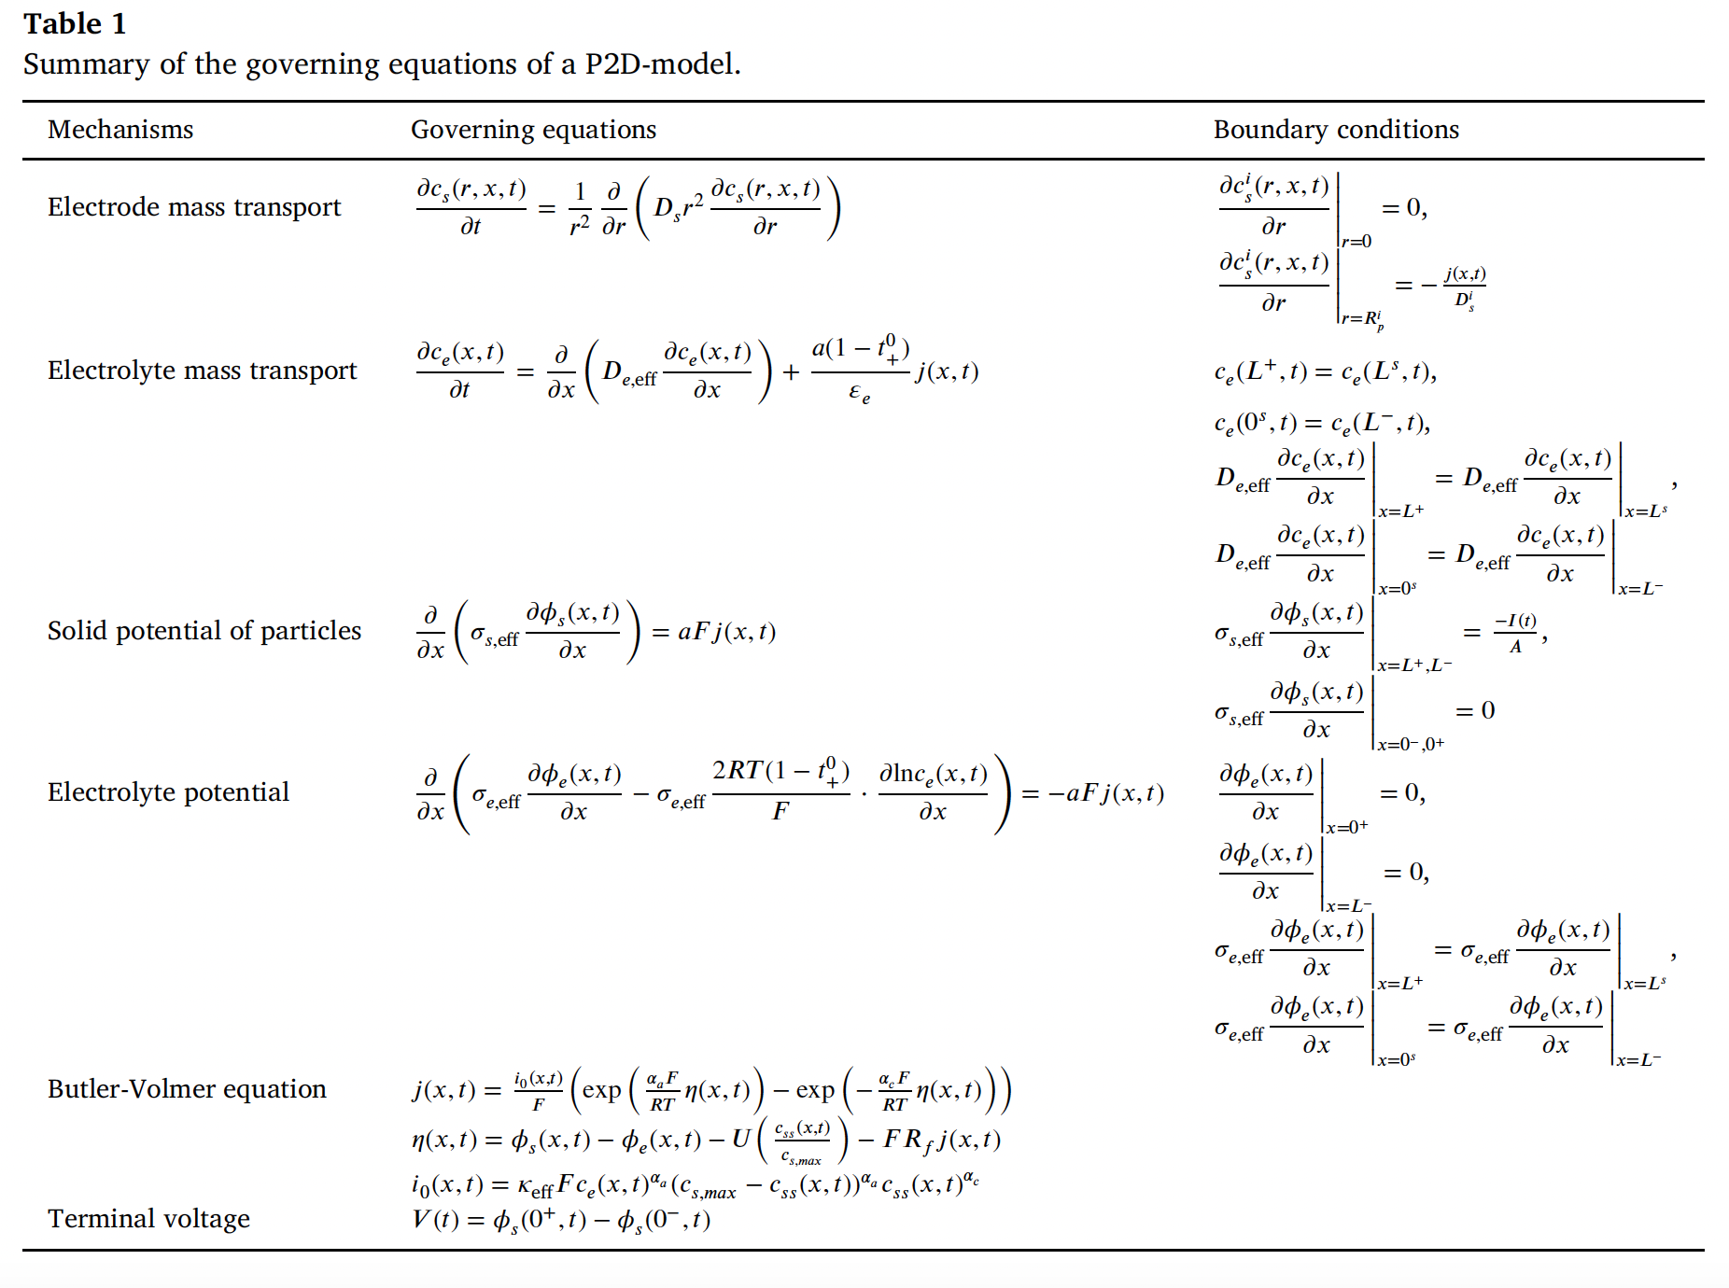
[1] W. Li et al., "Data-driven systematic parameter identification of an electrochemical model for lithium-ion batteries with artificial intelligence," Energy Storage Materials, vol. 44, pp. 557-570, 2022/01/01/ 2022, doi: https://doi.org/10.1016/j.ensm.2021.10.023.
DFN/P2D model: Equations summary
Notes:
Then, Here is the equations summary that used to build the DFN model.
It has two parts, which are governing equations and related boundary conditions.

Slide 13
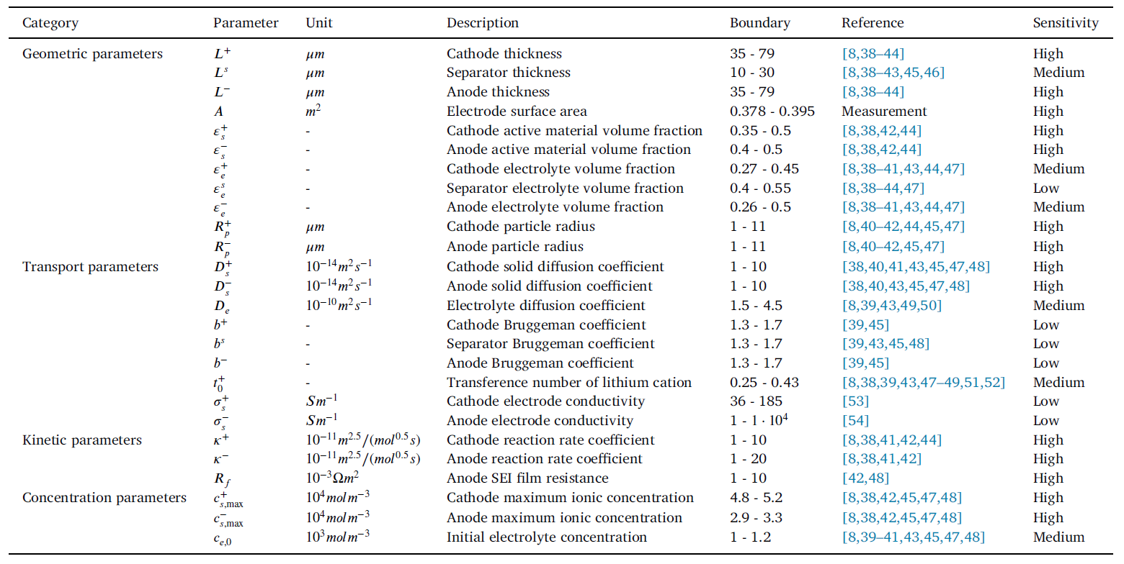
[1] W. Li et al., "Data-driven systematic parameter identification of an electrochemical model for lithium-ion batteries with artificial intelligence," Energy Storage Materials, vol. 44, pp. 557-570, 2022/01/01/ 2022, doi: https://doi.org/10.1016/j.ensm.2021.10.023.
DFN/P2D model: Parameters summary
Notes:
Here are parameters summary,
We have geometric parameters, transport parameters, kinetic parameters, and concentration param,eters.

Slide 14
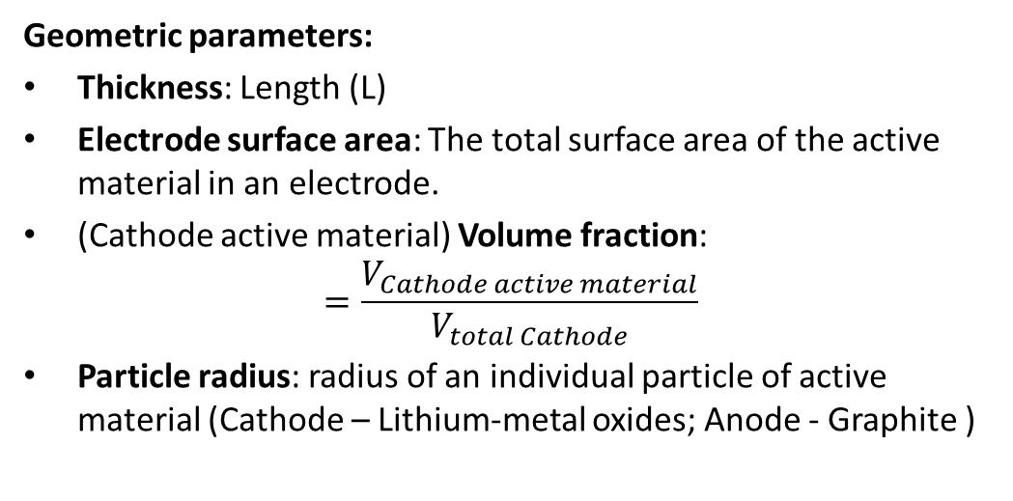
[1] N. A. Chaturvedi, R. Klein, J. Christensen, J. Ahmed, and A. Kojic, "Algorithms for Advanced Battery-Management Systems," IEEE Control Systems Magazine, vol. 30, no. 3, pp. 49-68, 2010, doi: 10.1109/MCS.2010.936293.
DFN/P2D model: Geometric parameters
Geometric parameters:
Thickness: Length (L)
Electrode surface area: The total surface area of the active material in an electrode.
(Cathode active material) Volume fraction: $=\frac{V_{Cathode active material}}{V_{total Cathode}}$
Particle radius: radius of an individual particle of active material (Cathode – Lithium-metal oxides; Anode - Graphite )
Notes:
First, geometric parameters.
Cathode, separator, and anode thickness. It’s the length
Electrode surface area: total surface area of the active material in electrode, so it’s not the cross-sectional area of the battery, instead, it’s the area of the active material.

Slide 15
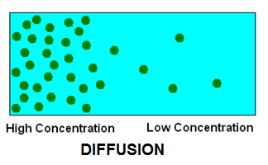
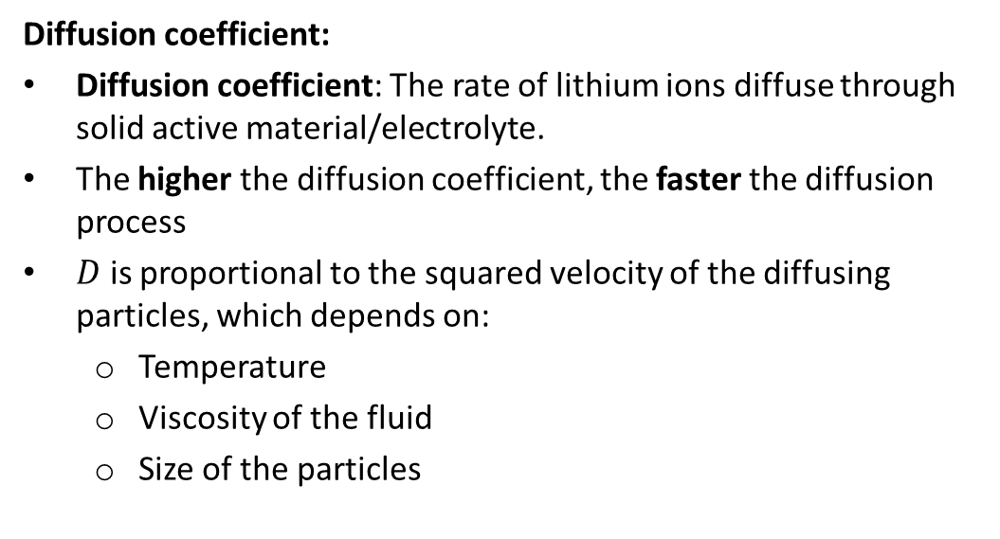
DFN/P2D model: Transport parameters
Diffusion coefficient:
Diffusion coefficient: The rate of lithium ions diffuse through solid active material/electrolyte.
The higher the diffusion coefficient, the faster the diffusion process
$D$ is proportional to the squared velocity of the diffusing particles, which depends on:
Temperature
Viscosity of the fluid
Size of the particles
Notes:
Next, let’s check transport parameters.
We know that particles tend to move from high concentration area to low concentration area, and this process is called diffusion.
And this is also true for lithium ions placed in the solid particles.
So the first transport parameters are diffusion coefficient for cathode, anode and electrolyte.
It determines the rate of lithium ions diffuse through solid active material or electrolyte. The higher the diffusion coefficient, the faster the diffusion process.
Diffusion coefficient is proportional to the squared velocity of the diffusion particles, which depends on temperature, viscosity of the fluid, and the size of the particles.

Slide 16
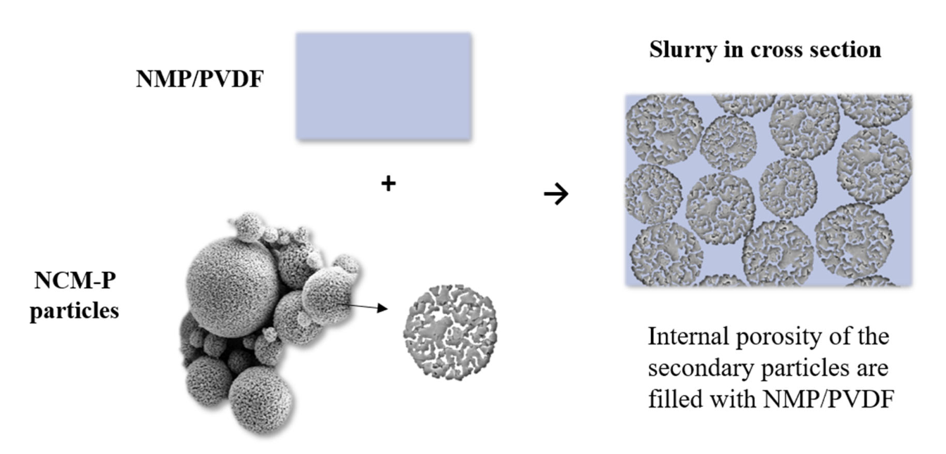
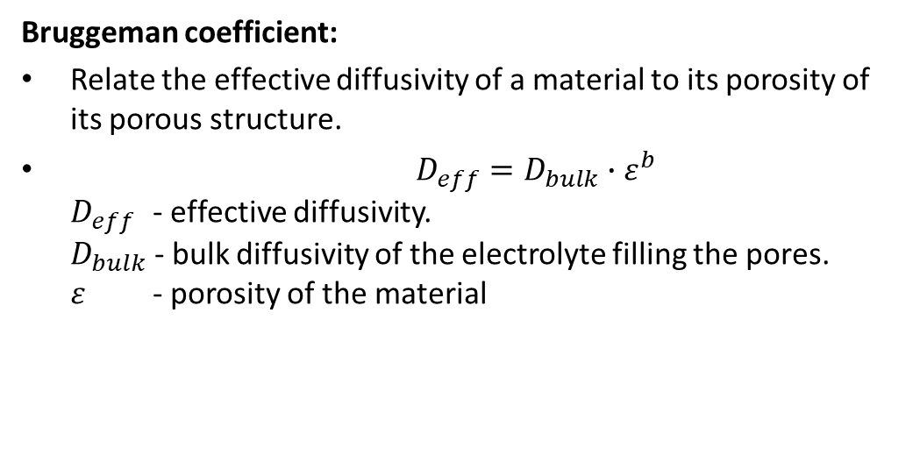
[1] J. Klemens et al., "Drying of NCM cathode electrodes with porous, nanostructured particles versus compact solid particles: comparative study of binder migration as a function of drying conditions," Energy Technology, vol. 10, no. 4, p. 2100985, 2022.
DFN/P2D model: Transport parameters
Bruggeman coefficient:
Relate the effective diffusivity of a material to its porosity of its porous structure.
$D_{eff}=D_{bulk}∙ε^{b}$ $D_{eff}$ - effective diffusivity. $D_{bulk}$ - bulk diffusivity of the electrolyte filling the pores. $ε$ - porosity of the material
NMC particles with porous structure.
Notes:
Next parameters are Bruggeman coefficient, for a solid particle, it’s actually not really solid, it’s porous stucuture, which means it has many holes on the surface of the solid particles.
You can see the figure here for a NMC particles.
So basically, these Bruggeman coefficient is related to the effective diffusivity of a material to its porosity of its porous structure.

Slide 17
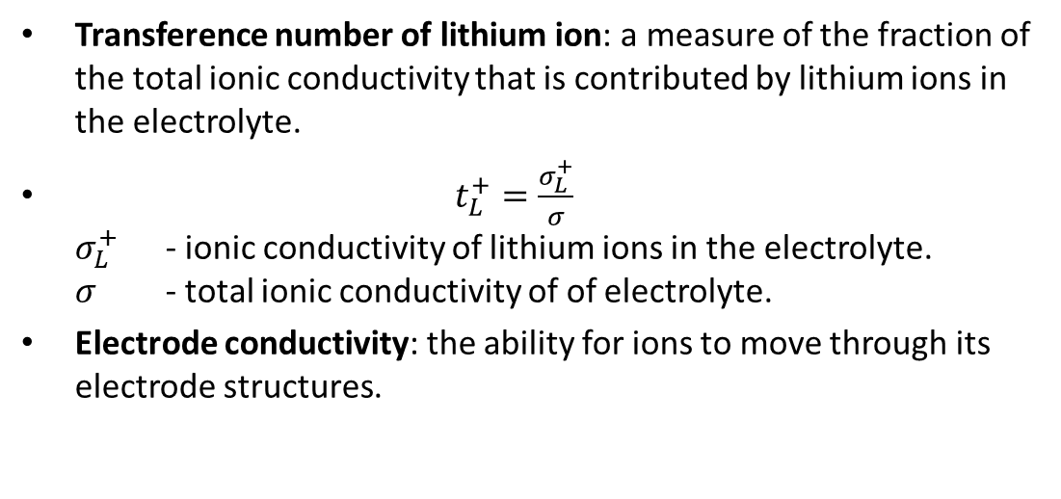
DFN/P2D model: Transport parameters
Transference number of lithium ion: a measure of the fraction of the total ionic conductivity that is contributed by lithium ions in the electrolyte.
$t_{L}^{+}=\frac{σ_{L}^{+}}{σ}$ $σ_{L}^{+}$ - ionic conductivity of lithium ions in the electrolyte. $σ$ - total ionic conductivity of of electrolyte.
Electrode conductivity: the ability for ions to move through its electrode structures.
Notes:
The transference number of lithium ion, is a measure of the fraction of total ionic conductivity that is contributed by lithium ions in the electrolyte.
And Cathode and anode electrode conductivity represents the ability for ions to move through its electrode structure.

Slide 18
[1] N. A. Chaturvedi, R. Klein, J. Christensen, J. Ahmed, and A. Kojic, "Algorithms for Advanced Battery-Management Systems," IEEE Control Systems Magazine, vol. 30, no. 3, pp. 49-68, 2010, doi: 10.1109/MCS.2010.936293.
DFN/P2D model: Kinetic and concentration parameters
Reaction rate coefficient: the rate of electrochemical reactions occur during battery operation.
Solid electrolyte interphase (SEI) film resistance: Can be measured using Electrochemical Impedance Spectroscopy (EIS) test.
Notes:
In the end, we have these kinetic and concentration parameters.
For Kinetic parameters, we have reaction rate coefficient, represents the rate of electrochemical reactions occur during battery operation.
And SEI film resistance due to the SEI layer between electrode and electrolyte. Normally, we can use EIS test to measure this SEI resistance.
Then, we have maximum possible ionic concentration in Cathode, anode, and initial electrolyte concentration. Which I already showed before, that can be used to calculate battery SOC.

Slide 19
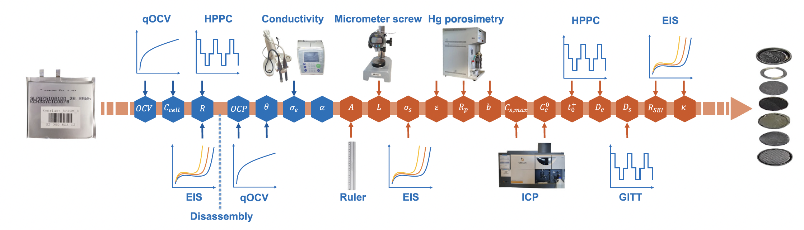
[1] W. Li et al., "Data-driven systematic parameter identification of an electrochemical model for lithium-ion batteries with artificial intelligence," Energy Storage Materials, vol. 44, pp. 557-570, 2022/01/01/ 2022, doi: https://doi.org/10.1016/j.ensm.2021.10.023.
DFN/P2D model: Parameters identification
DFN model parameters identification
Experimental method: characterization tests + open cells and measure parameters using specialized equipment.
Data-driven method: Similar to ECM model, run optimization algorithms (e.g, GA algorithm) to optimize parameters from battery operation data.
Notes:
So, there are so many parameters, you may wonder how can we identify these parameter values.
There are two ways to identify DFN model parameters: 1) experimental method, you will have to run several characterization tests including EIS, HPPC, GITT test, and also use some specialized equipment to destroy and open cell, to measure parameters such as conductibility and particle radius.
The benefic is you can skip all these tricky and specialized experiments, but downside is maybe you will get parameters that makes no physical sense, but some how works.

Slide 20
DFN MODEL MATLAB CODE DEMO
Notes:
Demo will be shared during lecture.

Slide 21
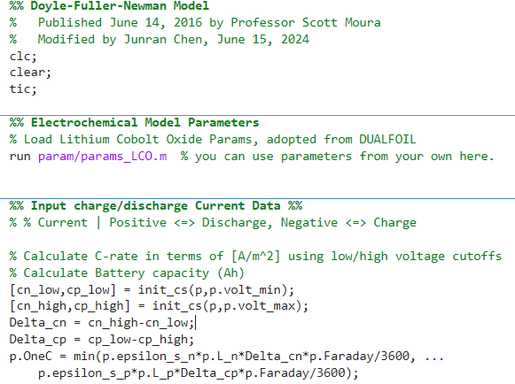
https://github.com/scott-moura/fastDFN
DFN/P2D model: MATLAB EXAMPLE
dfn_main.m
Obtain DFN model parameters
Calculate battery nominal capacity/ C-rate

Slide 22
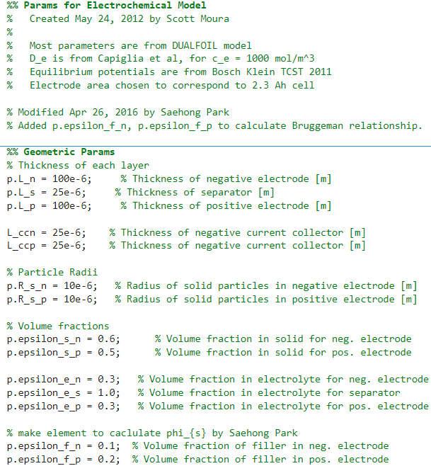
[1] J. C. Forman, S. J. Moura, J. L. Stein, and H. K. Fathy, "Genetic identification and fisher identifiability analysis of the Doyle–Fuller–Newman model from experimental cycling of a LiFePO4 cell," Journal of Power Sources, vol. 210, pp. 263-275, 2012/07/15/ 2012, doi: https://doi.org/10.1016/j.jpowsour.2012.03.009.
DFN/P2D model: Parameters
Params_LCO.m
Notes:
All the parameters are from this paper, it was using genetic algorithm to optimize cell parameters for the DFN model.
If you are interested, you can try that method to generate model parameters for yourself, or you can just use these parameters.

Slide 23
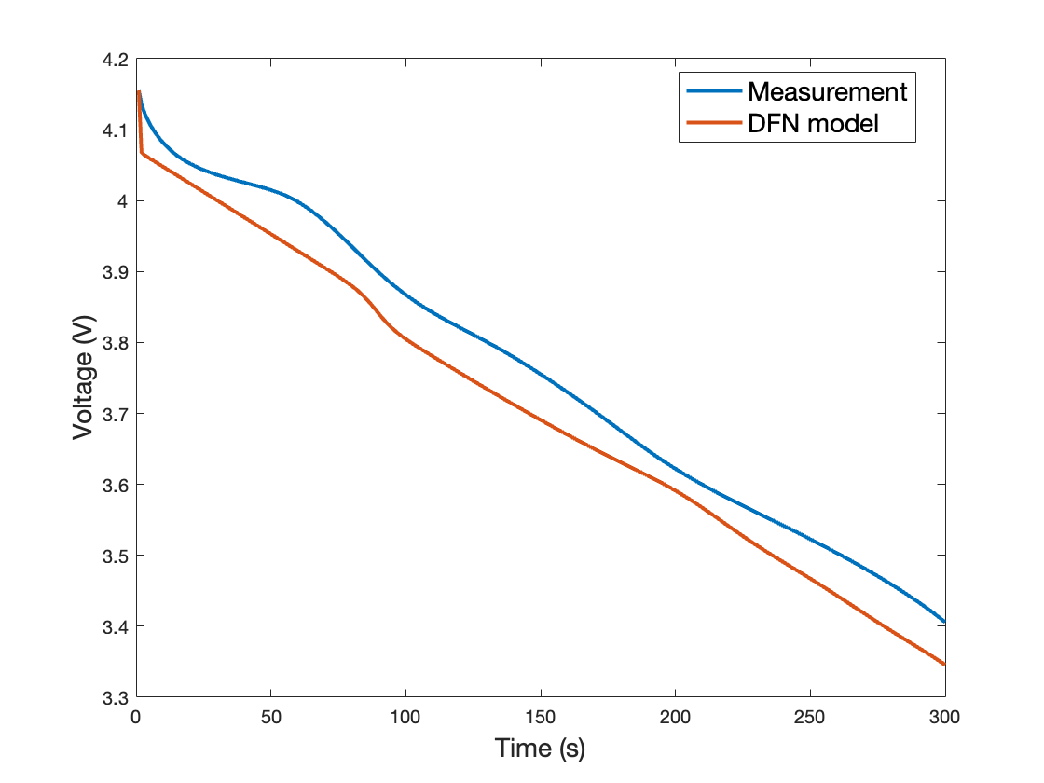
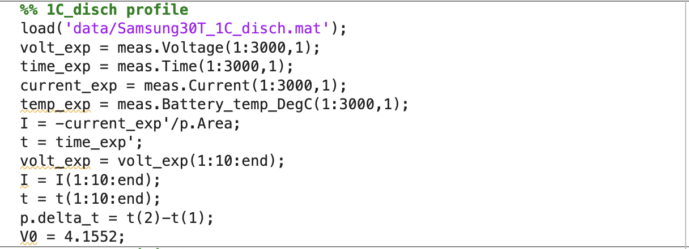
https://github.com/scott-moura/fastDFN
DFN/P2D model: 1C discharge profile

Slide 24
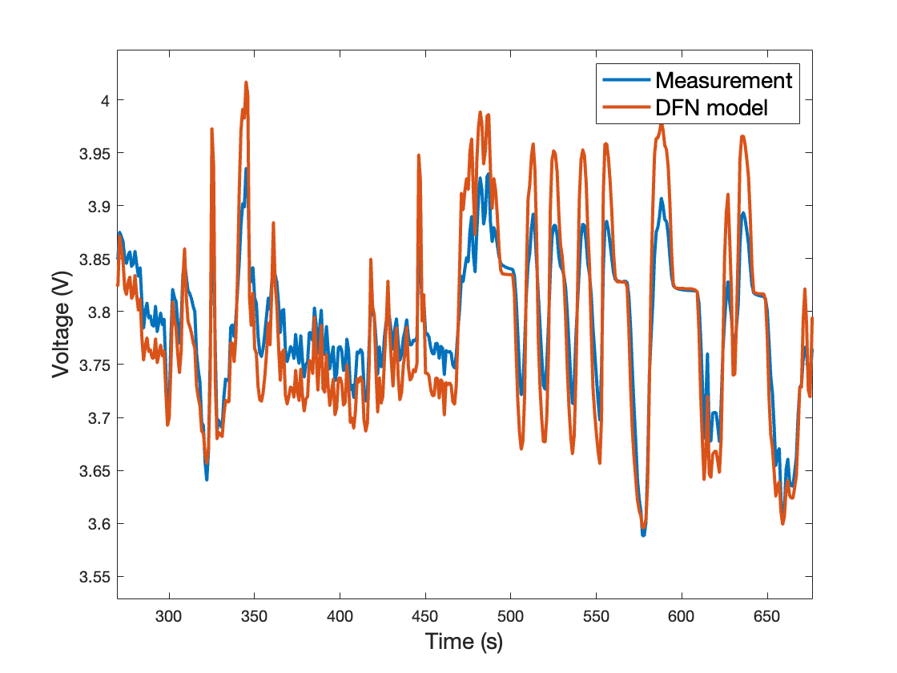
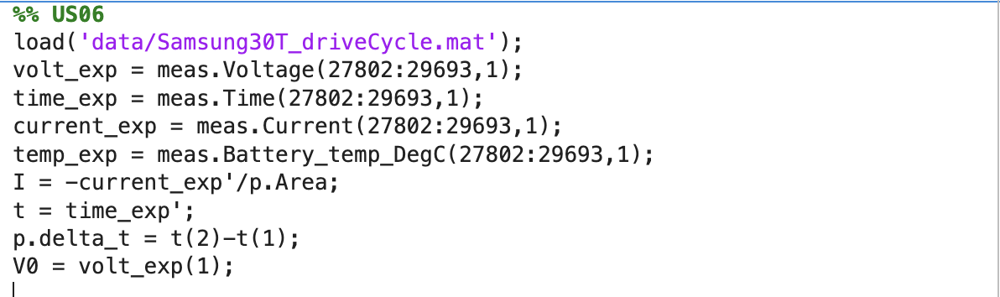
https://github.com/scott-moura/fastDFN
DFN/P2D model: US06 drive cycle profile

Slide 25
PYBAMM - PYTHON BASED ELECTROCHEMICAL MODELLING DEMO
Notes:
Demo will be shared during lecture.

Slide 26
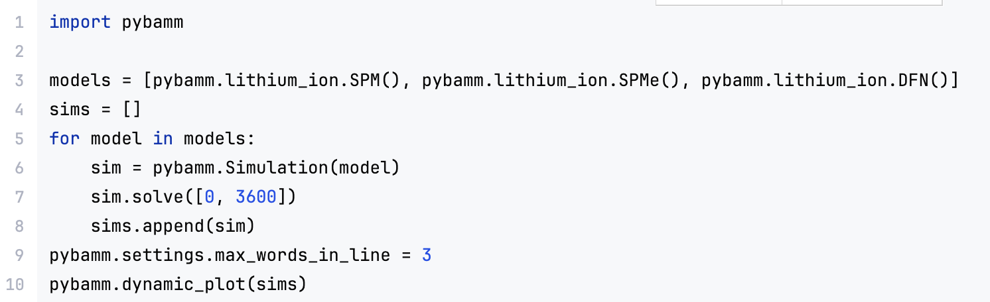
PyBaMM: a Python based battery electrochemical modelling tool
https://docs.pybamm.org/en/v23.4.1/index.html
Three models are compared here, including single-particle model (SPM), SPM with electrolyte (SPMe), DFN model.
Default 1 C-rate discharge profile

Slide 27
POTENTIAL GROUP PROJECTS

Slide 28
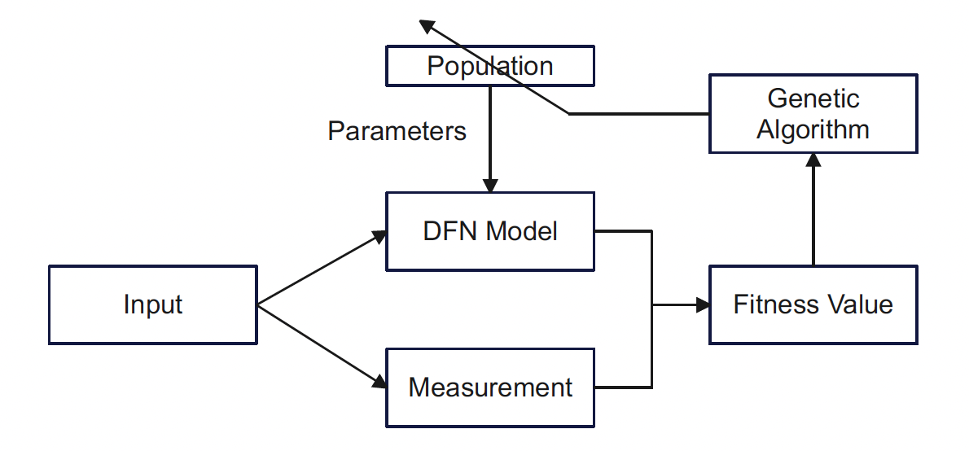
[1] J. C. Forman, S. J. Moura, J. L. Stein, and H. K. Fathy, "Genetic identification and fisher identifiability analysis of the Doyle–Fuller–Newman model from experimental cycling of a LiFePO4 cell," Journal of Power Sources, vol. 210, pp. 263-275, 2012/07/15/ 2012, doi: https://doi.org/10.1016/j.jpowsour.2012.03.009.
Potential Group projects: Electrochemical model parameters identification
Electrochemical parameters identification: Apply machine learning or optimization algorithms (e.g., Genetic algorithm and recursive least square algorithm) to identify battery electrochemical model parameters from easily accessible dataset.
Genetic algorithm based DFN model parameters identification

Slide 29
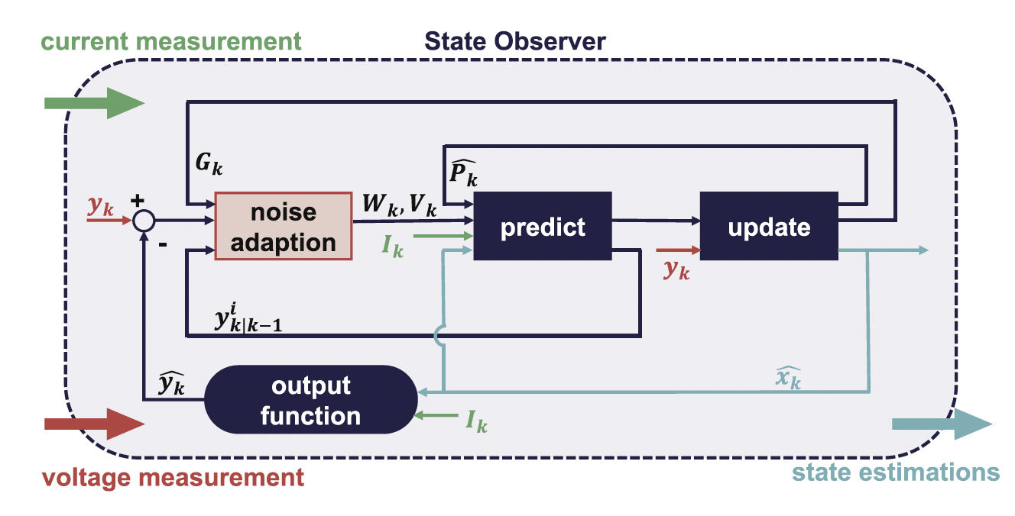
[1] W. Li et al., "Electrochemical model-based state estimation for lithium-ion batteries with adaptive unscented Kalman filter," Journal of Power Sources, vol. 476, p. 228534, 2020/11/15/ 2020, doi: https://doi.org/10.1016/j.jpowsour.2020.228534.
Potential Group projects: Battery state (SOC/SOH) estimation algorithm
Battery state (SOC/SOH) estimation: Combine electrochemical models with filter-based algorithms (e.g., extended Kalman filter, particle filter) to estimate battery state values.
(Battery SOC)
Voltage
Battery SOC estimator
Notes:
Battery SOC or SOH is an internal state of the electrochemical battery model, so basically the observer will try to update the internal states, which means SOC, to minimize the error between voltage estimation and measurement
Because theoretically, electrochemical model can be very accurate, so you can run the state observer on electrochemical model to estimate SOC.

Slide 30
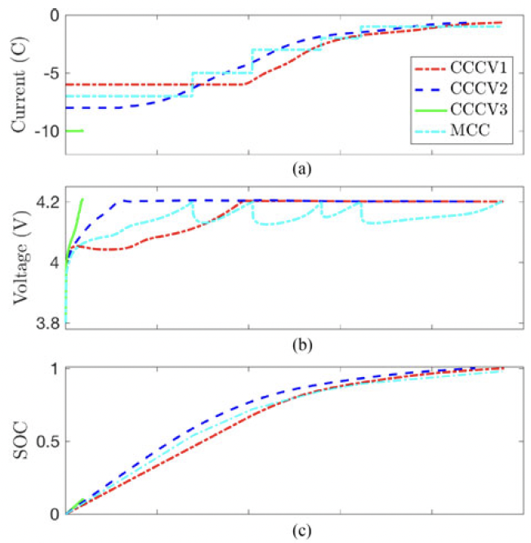
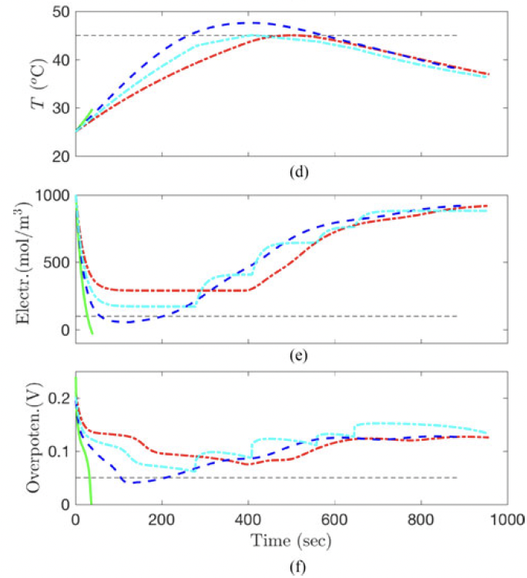
[1] C. Zou, X. Hu, Z. Wei, T. Wik, and B. Egardt, "Electrochemical Estimation and Control for Lithium-Ion Battery Health-Aware Fast Charging," IEEE Transactions on Industrial Electronics, vol. 65, no. 8, pp. 6635-6645, 2018, doi: 10.1109/TIE.2017.2772154.
Potential Group projects: Fast Charging control optimization
Charging profile optimization: Using an electrochemical model to find an optimized fast charging control strategy that
Minimizing charge time and cell degradation
Maintaining voltage, current, and temperature within safety limits.

Slide 31
Thank you!

